Slide 1
AMD Vivado™ AI Assistant: Introduction
2026.1 EA
Notes:
Welcome everyone.
Today we're introducing the AMD Vivado AI Assistant—a major step forward in how engineers interact with Vivado tool and AMD documentation. This is launching as an Early Access program in 2026.1, and we're excited to walk you through what we've built.

Slide 2
Agenda
1
Agentic AI is Here
What Vivado™ AI Assistant is
Productivity multiplier
2
The AI Foundation
MCP + Agent Skills: The guiding principle
IDE/CLI-agnostic AMD Vivado MCP Server (EA)
3
Knowledge & Intelligence
Vivado IDE docs search + knowledge base
Quality & benchmarking (Trustworthiness of retrieval)
Notes:
Let's quickly walk through today's agenda. We'll start with an overview of the Vivado AI Assistant—what it is and why we built it.
Then we'll cover real-world impact from field engineers already using it, followed by the technology architecture, the knowledge base, the MCP server capabilities, and finally how to get access.

Slide 3
Agenda
1
Agentic AI is Here
What Vivado™ AI Assistant is
Productivity multiplier
2
The AI Foundation
MCP + Agent Skills: The guiding principle
IDE/CLI-agnostic AMD Vivado MCP Server (EA)
3
Knowledge & Intelligence
Vivado IDE docs search + knowledge base
Quality & benchmarking (Trustworthiness of retrieval)
Notes:
Let’s start with the first topic—what the Vivado AI Assistant is and why it matters.

Slide 4
What Vivado AI Assistant Is
Tell the Vivado™ tool what to do — in plain English
What Can You Do?
1
Search AMD Documentation — No Vivado Tool Needed
System Architect
RTL Developer
Timing Closure Specialist
Hardware Debug Specialist
How to configure NoC for optimal bandwidth?
RTL coding best practices for synthesis?
How to fix setup violations on high-fanout nets?
PDI boot failure troubleshooting on AMD Versal™ devices?
→ UG1388, UG1504, PG313
Use traffic classes (best effort, isochronous, low latency)
with bandwidth allocation per route
→ UG901, UG1387, UG949
Follow UG901 guidelines. Use RAM_STYLE, SHREG_EXTRACT,
MAX_FANOUT attributes. Avoid latches
→ UG949, UG1387, AR#53430
Use report_high_fanout_nets after synthesis.
Apply MAX_FANOUT or manual replication
→ UG1304, UG908, AR#76655
Check boot mode pins (SW1). Verify PDI in JTAG/flash/SD
Boot via HW Manager. Check PMC error codes
Notes:
At its core, the Vivado AI Assistant lets you tell the Vivado tool what to do—in plain English. There are three ways to use it.
First, you can search AMD documentation without even having the Vivado tool installed—just ask questions and get expert answers grounded in over 500 user guides and application notes.

Slide 5
What Vivado AI Assistant Is
Tell the Vivado™ tool what to do — in plain English
What Can You Do?
2
Drive the Vivado Tool with Natural Language
"Open my project and show me the utilization summary"
Agent runs open_project, then report_utilization—presents LUT, FF, BRAM, DSP, and I/O usage as a clean table
Flags any resource above 80% utilization
“What are the worst 10 timing paths?”
Agent runs report_timing_summary, parses the output, and shows the critical paths ranked by slack—with source, destination, clock domain, and delay breakdown.
Notes:
Second, you can connect to a live Vivado IDE session and drive it conversationally—open projects, check utilization, read timing reports, all without memorizing Tcl syntax.

Slide 6
What Vivado AI Assistant Is
Tell the Vivado™ tool what to do — in plain English
What Can You Do?
3
Run Skill-driven Workflows
"Run RTL lint and fix all issues“
Agent opens project, runs synth_design -lint, categorizes violations by severity, looks up fix guides in AMD docs, patches your RTL, and re-verifies—all in one prompt
"Analyze timing violations and generate fix strategies"
Agent follows a skill-driven methodology: classify failing paths by root cause, suggest constraint changes with real cell and net names, rerun implementation, and measure improvement—iteratively
"Compare all implementation runs"
Agent discovers four runs, extracts timing, congestion, and utilization from each, ranks them by QoR score, and generates an interactive dashboard with five visualization tabs
"Debug the AXI protocol violation"
Agent runs XSim, catches the assertion, opens a color-coded waveform, traces the root cause through the AXI handshake, and waits for your approval before fixing
Notes:
Third, you can run skills-driven workflows—expert-authored markdown files that encode FPGA methodology so the agent follows a proven set of steps, like a senior engineer would.

Slide 7
AMD Vivado AI Assistant: A Productivity Multiplier
Examples from field team members already using the AI tools
On-Demand Design Creation
Automated Timing Closure
Debug Acceleration
Full Versal™ Gen 2 NoC test design (traffic generator, NMU/NSU, memory responder) from one prompt
MPRAM duplication for hardware debug: urgent customer query to working design in under two hours on a Saturday
Auto-generated DCMAC/MRMAC example designs, all the way through Vitis™ software platform
Single command drove agent to iterate until WNS >= 0
LLM-driven RTL optimization took a design with TNS -260 to -9 in 5 prompts with no manual edits
Natural-language directive sweeps produce reusable TCL recipes
Complex Cross-IP SerDes debug with DCMAC and MRMAC, 5-10x speed up without combing through ~1000 pages of Product Guides
Vivado™ IDE version migration caused a Versal AI Edge Series Gen 2 performance regression. Root caused to NoC QoS change in half a day versus ~two weeks
PLM boot issue decoded and root caused in seconds
Notes:
Now that you’ve seen what the assistant can do, let’s look at the real impact it’s already delivering in practice, with examples coming directly from field engineers who have been getting hands-on with early versions of the tool.
On the design creation side, engineers have generated full Versal Gen 2 NoC test designs from a single prompt—including traffic generators, NMU and NSU blocks, and memory responders. One engineer solved an urgent customer query on a Saturday in under two hours.
For timing closure, a single command drove the agent to iterate until WNS went above zero. One design went from TNS of minus 260 to minus 9 in just five prompts with no manual edits.
In debug acceleration, complex Cross-IP SerDes issues involving DCMAC and MRMAC were resolved 5 to 10 times faster than reading through roughly 1000 pages of product guides. A Versal performance regression was root-caused in half a day instead of two weeks.
These results are real—they come from our field team in their day-to-day work with customer designs.

Slide 8
Why AMD Vivado AI? Meets Distinct Needs of Each User
Design Architect
Design Capture
Design Analysis
Design Closure
Hardware Debug
System Architect
RTL Developer
Verification Engineer
Timing Expert
Hardware Lab
CHALLENGE
CHALLENGE
CHALLENGE
CHALLENGE
CHALLENGE
Slow design exploration & device selection
Extensive Tcl & IPI hand-coding, no style enforcement
Overwhelming logs & reports, manual triage across runs
Iterative guesswork with low timing & DRC closure hit-rates
Complex NoC, DDR, PCIe® link & PDI load debugging
PROMPT
PROMPT
PROMPT
PROMPT
PROMPT
Explore Zynq™ UltraScale+™ options for my video pipeline use case
Compare AMD Versal™ vs Zynq for my AI inference workload
Create IPI block design with Zynq PS, AXI GPIO & Timer
Check my RTL for best practices—style & pragmas
47 critical warnings—which ones matter and what to fix?
Identify critical paths & congestion hotspots post-synthesis
3 failing timing paths after 8 implementation runs—what next?
Suggest constraints for this clock domain crossing violation
PDI boot fails on Versal VCK190 devices after adding NoC—what's wrong?
My DDR calibration fails at 3200 MT/s—debug steps?
OUTCOME
OUTCOME
OUTCOME
OUTCOME
OUTCOME
RAG-backed guided exploration & device recommendations
Natural language to IPI/RTL design + RTL best practices
Prioritized issues with fixes, critical path & congestion
Evidence-backed suggestions, improved closure hit-rate
Rapid hardware bring up via agentic AI workflows
Notes:
One of the key design principles behind this tool was that it had to serve every persona across the FPGA design cycle—not just one.
From the system architect choosing a device, to the RTL developer capturing the design, to the verification engineer triaging logs, to the timing expert closing the design, and all the way to the hardware lab engineer debugging live silicon.
Each of these roles has different challenges, and the AI assistant is designed to address all of them. Architects can explore device options conversationally. RTL developers can generate block designs from natural language. Verification engineers can prioritize critical warnings.
Timing specialists get evidence-backed constraint suggestions. And hardware engineers can debug PDI boot failures or DDR calibration issues with AI-driven root cause analysis—all through a simple prompt.

Slide 9
Agenda
1
Agentic AI is Here
What Vivado™ AI Assistant is
Productivity multiplier
2
The AI Foundation
MCP + Agent Skills: The guiding principle
IDE/CLI-agnostic AMD Vivado MCP Server (EA)
3
Knowledge & Intelligence
Vivado IDE docs search + knowledge base
Quality & benchmarking (Trustworthiness of retrieval)
Notes:
So far, you’ve seen what the Vivado AI Assistant can do and the kind of impact it delivers. Now, let’s look at what’s behind it—the AI foundation that makes all of this possible.

Slide 10
Guiding Principle: Follow Industry Standards
MCP gives the information
Agent Skills give the power to act
MCP
The Information Layer
Agent Skills
The Action Layer
Model Context Protocol
Open standard by Anthropic—adopted across the industry
Anthropic Open Standard
Markdown files encoding domain expertise as executable workflows
What it provides:
Tool Discovery—LLM discovers available AMD Vivado™ tools at runtime
Knowledge Access—Retrieval-augmented generation (RAG)-powered search across 15+ user guides
Session Control—Start, stop, monitor AMD Vivado™ IDE sessions
Execution Bridge — Run any Tcl command via standardized API
What it provides:
Autonomous Workflows—Multi-step Vivado flows run end-to-end
Domain Expertise—CDC review, congestion analysis, timing closure
Structured Execution—Real TCL commands, decision trees, no hallucination
Actionable Reports—REPORT.md with real cell names & fix commands
Why it matters:
IDE-agnostic—Visual Studio® Code, Cursor, Claude Code, Windsurf, any MCP client
LLM-agnostic—Claude, GPT, Gemini, Qwen, Llama—any model
Why it matters:
Repeatable—Same skill, same results—eliminates tribal knowledge
Shareable—Version-controlled, portable across teams & organizations
Works with :
VS Code
Cursor
Claude Code
Windsurf
OpenCode CLI
Any MCP-compatible client
Notes:
The philosophy we adopted from the start was to build on Anthropic open standards rather than create a proprietary lock-in. There are two layers.
The information layer uses the model context protocol (MCP), which was originally created by Anthropic and is now part of the Linux Foundation as an open standard. MCP is what makes our solution IDE-agnostic and LLM-agnostic. Whether you're using VS Code, Cursor, Claude Code, or Windsurf—whether you're running Claude, GPT, Gemini, Qwen, or Llama—the MCP protocol works the same way.
The action layer uses agent skills—another open standard from Anthropic. Skills are markdown files that encode domain expertise as executable workflows. They are repeatable, version-controlled, portable, and sharable across teams. The combination of MCP and skills is what enables true agentic AI for FPGA design.

Slide 11
Framework Enabling Agentic AI Design Flow
MCP Clients
LLM-Driven IDEs & CLIs
VS Code
Cursor
Claude Code
Windsurf
OpenCode CLI
Any MCP-compatible client
Agent Skills execute here—Autonomous FPGA workflows powered by domain expertise
MCP Protocol
AMD Vivado™ IDE MCP Server
Local to Vivado Install
vivado_doc_search
RAG-powered search across AMD documentation
Example: "How to handle async clocks?"
vivado_execute
Run any Tcl command through a standardized API
Example: "Analyze critical paths and recommend fixes"
Vivado IDE
Software Platform
PDM
ChipScope
Model Composer
TCL & GUI
Project & Non-project
Any Vivado IDE Version
Vivado Tool Knowledge Base
Local or Remote
Vivado Software
Local Installation
Multi-GB vectorized database with semantic search
Tools including Vivado, Vitis, PDM, ChipScope, Model Composer
Datasheets, white papers, answer records
Tutorials, wiki, labs, and examples
Supports any previous version of Vivado Design Suite
Full Tcl and GUI access
Project & non-project mode
Synthesis, implementation, bitstream
Notes:
Let us now look at the full framework enabling agentic AI design flow.
At the bottom left is the Vivado tool knowledge base—this is the brain of the system. It's a multi-gigabyte vectorized database containing user guides, product guides, datasheets, white papers, answer records, wiki pages, and GitHub tutorials. Agents are only as good as the data they see, so grounding the AI in authoritative AMD documentation is critical.
To the right is the local Vivado IDE installation—supporting any previous version of the Vivado Design Suite that has web server support, going back at least ten years.
In the middle is the AMD Vivado MCP Server, which has two primary functions: vivado_doc_search for a RAG-powered documentation retrieval, and vivado_execute for running any Tcl command in a live Vivado IDE session.
At the top are the MCP Client IDEs and CLIs—VS Code, Cursor, Claude Code, Windsurf, and others—this is where the user interacts, and where agent skills are executed.

Slide 12
First Delivery: IDE/CLI Agnostic AMD Vivado MCP Server
Vivado™ MCP Server
MCP Client IDEs
vivado_doc_search
RAG-powered documentation search
vivado_execute
Run Tcl commands & GUI control
vivado_analyze
Reports, timing, CDC analysis
Claude Desktop
Cursor
VS Code
MCP
Windsurf
Antigravity
Vivado Tool Knowledge Base Local or Remote
Vivado & Vitis™ tools
UG835, UG906, UG949
PDM & ChipScope
Debug & program tools
MCP Client CLIs
Model Composer
DSP & AI design docs
Datasheets & More
Specs, wiki, ARs
Multi-GB vectorized database with semantic search (RAG)
Vivado IDE, Vitis software platform, PDM, ChipScope, Model Composer docs
Runs as Docker® container—local or remote deployment
Context-aware results ranked by relevance
Claude Code
Cursor CLI
MCP
GitHub Copilot CLI
Notes:
Our first delivery is the Vivado MCP Server, which is available as part of the Early Access Program. It includes three tool categories.
The doc search tool provides RAG-powered access to the knowledge base—over 500 user guides, application notes, data sheets, answer records—all in a multi-gigabyte vectorized database deployed as a Docker container that can run locally or be hosted remotely.
The execute tool lets agents run any TCL command in a live Vivado IDE session.
The analyze tool handles reports, timing, and CDC analysis.
The list of supported MCP clients—Claude Desktop, Cursor, VS Code, Windsurf, and others — is what we're internally validating, but architecturally the server works with any MCP-compatible client.

Slide 13
Agenda
1
Agentic AI is Here
What Vivado™ AI Assistant is
Productivity multiplier
2
The AI Foundation
MCP + Agent Skills: The guiding principle
IDE/CLI-agnostic AMD Vivado MCP Server (EA)
3
Knowledge & Intelligence
Vivado IDE docs search + knowledge base
Quality & benchmarking (Trustworthiness of retrieval)
Notes:
Now that you’ve covered how the system is built and how it operates, let’s focus on the intelligence behind it — the knowledge base that makes the assistant accurate and reliable.

Slide 14
Access Knowledge Base: Real Questions, Expert Answers
System Architect
RTL Developer
Timing Closure Specialist
Hardware Debug Specialist
How to configure NoC for optimal bandwidth?
How to constrain async clock domain crossings?
How to fix setup violations on high-fanout nets?
PDI boot failure troubleshooting on AMD Versal devices?
→ UG1388, UG1504, PG313
Use traffic classes (Best Effort, Isochronous, Low Latency)
with bandwidth allocation per route
→ UG903, UG1387, UG949
Use XPM_CDC macros. Apply ASYNC_REG attributes
set_false_path / set_max_delay constraints
→ UG949, UG1387, AR#53430
Use report_high_fanout_nets after synthesis
Apply MAX_FANOUT or manual replication
→ UG1304, UG908, AR#76655
Check boot mode pins (SW1). Verify PDI in JTAG/flash/SD
Boot via HW Manager. Check PMC error codes
Which AMD Versal™ device supports my AI inference workload?
RTL coding best practices for synthesis?
What phys_opt_design techniques help timing?
DDR calibration debug using DDRMC in the AMD Vivado™ tool?
→ DS957, UG1504
Versal AI Edge (VE2302, VE2802) with integrated AI Engines
for INT8/INT4 inference. 400+ TOPS
→ UG901, UG1387, UG949
Follow UG901 guidelines. Use RAM_STYLE, SHREG_EXTRACT,
MAX_FANOUT attributes. Avoid latches
→ UG904, UG949, UG1387
Post-place and post-route phys_opt_design.
Use -fanout_opt, -placement_opt, -retime
→ UG908
DDRMC debug always enabled in Versal devices. HW Manager reads
calibration status, R/W window margins
Powered by RAG—500+ User Guides, Application Notes & Knowledge Base Articles
UG903 · UG904 · UG908 · UG949 · UG1387 · UG1388 · UG1504 · PG313 · DS957 · AM011 · UG901 · AR Articles · and more
Notes:
This slide shows what the knowledge base looks like from a user's perspective across different roles.
A system architect can ask how to configure NoC for optimal bandwidth and get a precise answer citing UG1388 and PG313—with traffic class recommendations and bandwidth allocation guidance.
An RTL developer can ask which about constraining async clock domain crossings and get the exact XPM_CDC macros, ASYNC_REG attributes, and set_false_path syntax from UG903 and UG949.
A timing closure specialist can ask how to fix setup violations on high-fanout nets and quickly get guidance, including the use of the report_high_fanout_nets command and recommended optimization techniques.
A hardware debug specialist can ask about troubleshooting PDI boot failures and receive targeted insights on where to debug on the board and how to narrow down the root cause.
Every response cites the source document and links to the specific section—not just the document title.

Slide 15
Deep Dive: Knowledge Database
COVERAGE
What's Inside
SMART TAGGING
How It's Organized
INTELLIGENT SEARCH
How It Finds Answers
CONTEXT AWARENESS
Why It's Better
Cross-referenced Answers
Web documentation
PDF user & product guides
Knowledge base (answer records)
Blog articles & design tips
Embedded wiki (Linux®, u-boot)
Github reference designs
Source Classification
Web docs
Knowledge base
PDF docs
Dual Retrieval Engine
Keyword matching for TCL commands, register names, error codes
Semantic understanding for natural language questions
Cross-Referenced Answers
Results link to related docs
e.g., UG949 → UG903 → UG1387
Design advisories auto-surfaced
Blog
Wiki
GitHub
Document ID Taxonomy
UG
PG
DS
WP
AR#
AM
Design-Phase Mapping
Matches query to design stage
RTL → Synth → Impl → Debug
Phase-appropriate doc priority
Flexible Search Modes
Precision: exact term lookup
Balanced: keyword + semantic
Exploration: intent-based discovery
Product & Tool Coverage
AMD Versal™ AI Edge / Premium / HBM
Zynq™ UltraScale+™ MPSoC & RFSoC
AMD 7 Series, Spartan™ 6, Virtex™ 6/5 FPGAs
Vivado™ IDE, Vitis™ software platform, PetaLinux, ISE™ design suite
Section-Level Indexing
Deep links to exact doc sections
UG903 → Async Clock groups
UG1304 → PLM responsibilities
UG949 → CDC methodology
Actionable Responses
Full context excerpts, not titles
Tcl commands included inline
Step-by-step guidance from UGs
Result Control
Adjustable depth: focused answer to comprehensive survey
Every result cites doc ID + URL
Notes:
Let’s go deeper into what makes the knowledge base powerful.
On coverage—the database includes web documentation, PDF user and product guides, knowledge base answer records, blog articles, the embedded Linux and U-Boot wiki, and GitHub reference designs. It spans AMD Versal, UltraScale+, and older device families, and includes documentation for all the associated tools—Vivado, Vitis, PDM, ChipScope, and Model Composer.
Smart tagging is what makes retrieval intelligent. Every document is classified by source type, tagged with document IDs like UG or PG or AR, and indexed at section level—so results point to the exact section within a thousand-page user guide, not just the top-level document.
The search engine supports three modes—precision for exact term lookup, balanced for keyword plus semantic understanding, and exploration for pure intent-based discovery.
And context awareness means the agent can correlate the search results against your actual design, so recommendations are tailored to your specific project rather than being generic.

Slide 16
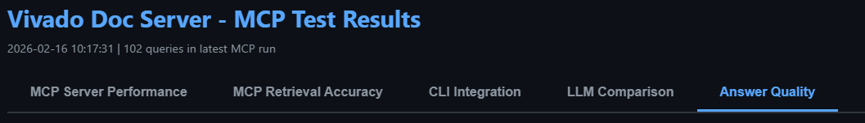
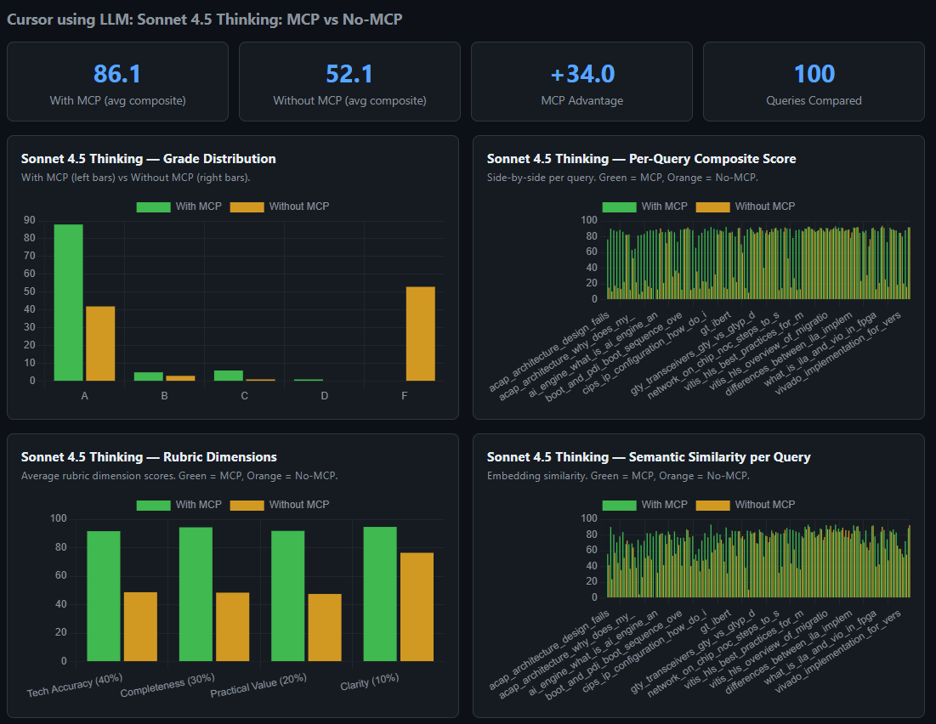
Why AMD Vivado IDE Knowledge is Critical for Agentic AI Flow
LLMs without MCP often search the internet and can be wrong on Vivado™ IDE questions
MCP doc search pulls answers from authoritative AMD sources
Measured using SME-created ground-truth Q/A pairs to test LLMs with and without MCP
Result: Deliver consistently more accurate responses
Cursor CLI using Sonnet 4.5 LLM w/ & w/o Docs MCP
Notes:
This slide explains why proprietary, domain-specific knowledge differentiates the agentic AI from generic LLMs.
When you ask an LLM without our MCP server a Vivado IDE-specific question, it will try to find information from the internet—and often get it wrong or hallucinate. When you use our doc search, the answer comes from authoritative AMD sources—user guides, answer records, design examples—and the response is grounded, cited, and directly actionable.
This difference was measured with a grading mechanism where subject-matter experts write ground truth query-answer pairs, and tested LLMs with and without our MCP server.
The results consistently show significantly more accurate responses when the MCP-connected knowledge base is used.

Slide 17
AMD Vivado MCP Tool Reference
☷ vivado_doc_search
RAG-powered documentation search—Foundation for all agent responses
19 tools • 6 categories • MCP Protocol
Session
Monitoring
LSF / HPC
vivado_start Launch Vivado™ tool (TCL or GUI mode)
vivado_stop Close the active session
vivado_connect Connect to external webserver
vivado_list_sessions List all active sessions
vivado_cleanup Remove stale sessions & orphans
vivado_status Process status & command queue
vivado_log_messages Parse log for errors & warnings
vivado_run_status Check synth/impl run progress
vivado_run_health Detect & recover stuck runs
vivado_lsf_start Launch Vivado IDE on cluster via bsub
vivado_lsf_status Check job: PEND / RUN / DONE / EXIT
vivado_lsf_kill Kill a job by ID or session ID
Execution
Utilities
Productivity
vivado_execute Run any Tcl command in Vivado IDE
vivado_history Search session command history
vivado_display_check Verify X11 display before GUI launch
vivado_client_info Get connected MCP client details
vivado_todos Manage a persistent task/todo list
vivado_show_todos Display todos in formatted sidebar view
Notes:
Now let’s look at the actual tools the agent uses to interact with the Vivado IDE.
Displayed here is the full reference of all 19 tools across 6 categories available in the Vivado MCP Server.
The foundation tool is vivado_doc_search—the RAG-powered documentation search that every agent response depends on.
The session tools—vivado_start, vivado_stop, vivado_connect, vivado_list_sessions, and vivado_cleanup—let the agent manage the Vivado IDE instances.
Monitoring tools like vivado_status, vivado_log_messages, vivado_run_status, and vivado_run_health let the agent check what's happening in a running the Vivado IDE session and even recover stuck runs.
LSF tools—vivado_lsf_start, vivado_lsf_status, vivado_lsf_kill—enable launching and managing the Vivado IDE jobs on HPC clusters, which is critical for enterprise users doing CI/CD flows.
Execution tools—vivado_execute and vivado_history—let the agent run Tcl commands and review past interactions.
Utility tools like vivado_display_check and vivado_client_info help manage the connection and environment.
Productivity tools like vivado_todos and vivado_show_todos — let the agent maintain a persistent task list across sessions.

Slide 18
Summary
01
The AMD Vivado™ AI Assistant lets you search AMD docs, drive Vivado tools, and run full FPGA workflows using plain English
02
Enables faster debugging, same-day root cause analysis, and complete design generation from a single prompt
03
Built on MCP and Agent Skills, making it IDE-agnostic and LLM-agnostic out of the box
04
Covers doc search, Tcl execution, session management, monitoring, HPC/LSF support, and productivity tools in one server
Notes:
Let’s summarize the key takeaways from this session.
This module introduces the AMD Vivado AI Assistant for AMD FPGA workflows, enabling users to search documentation, drive the Vivado tools, and execute complete design flows using plain English.
It accelerates debugging and root cause analysis and supports full design generation from a single prompt.
Built on MCP and Agent Skills, it is both IDE-agnostic and LLM-agnostic.
All capabilities are unified in one server, covering doc search, Tcl execution, session management, monitoring, and HPC/LSF support.

Slide 19
Disclaimer and Attributions
The information contained herein is for informational purposes only and is subject to change without notice. While every precaution has been taken in the preparation of this document, it may contain technical inaccuracies, omissions and typographical errors, and AMD is under no obligation to update or otherwise correct this information. Advanced Micro Devices, Inc. makes no representations or warranties with respect to the accuracy or completeness of the contents of this document, and assumes no liability of any kind, including the implied warranties of noninfringement, merchantability or fitness for particular purposes, with respect to the operation or use of AMD hardware, software or other products described herein. No license, including implied or arising by estoppel, to any intellectual property rights is granted by this document. Terms and limitations applicable to the purchase or use of AMD products are as set forth in a signed agreement between the parties or in AMD's Standard Terms and Conditions of Sale. GD-18u © 2026 Advanced Micro Devices, Inc. All rights reserved. AMD, the AMD Arrow logo, ISE, Spartan, UltraScale+, Versal, Virtex, Vitis, Vivado, Zynq, and combinations thereof are trademarks of Advanced Micro Devices, Inc. Docker and the Docker logo are trademarks or registered trademarks of Docker, Inc. Linux is the registered trademark of Linus Torvalds in the U.S. and other countries. PCIe is a registered trademark of PCI-SIG Corporation. Visual Studio® is a registered trademark of Microsoft Corporation in the United States and/or other countries. Other product names used in this publication are for identification purposes only and may be trademarks of their respective owners. Certain AMD technologies may require third-party enablement or activation. Supported features may vary by operating system. Please confirm with the system manufacturer for specific features. No technology or product can be completely secure.

Slide 20
Notes:
Thank you for joining this session on AMD Vivado™ AI Assistant: Introduction.
For questions, reach out through the Early Access forum or the #vivado_general Slack channel.

